Slide 1

S-100 Geospatial Information Registry Workshop Aalborg, Denmark – 25-26 February 2019
International Hydrographic Organization

Slide 2
GI Registry Workshop - Aims
Understanding current structure of the IHO GI Registry
Understanding current structure of the “new” IHO GI Registry
Discuss possible improvements to the “new” Registry structure
Understanding the GI Registry Interface
Advance development of “conventions and guidelines” for the IHO GI Registry
Rationalization of Registry content
Discuss (and agree?) on possible new data modelling concepts for the Registry (for example utilization of concept specializations (URNs, Namespaces))
Introduction to Registry associated tools
Feature Catalogue Builder
Portrayal Catalogue Builder

Slide 3
3.1 Registry structure and roles (current)
Presentation “IHO GI Registry – Mar 19”

Slide 4
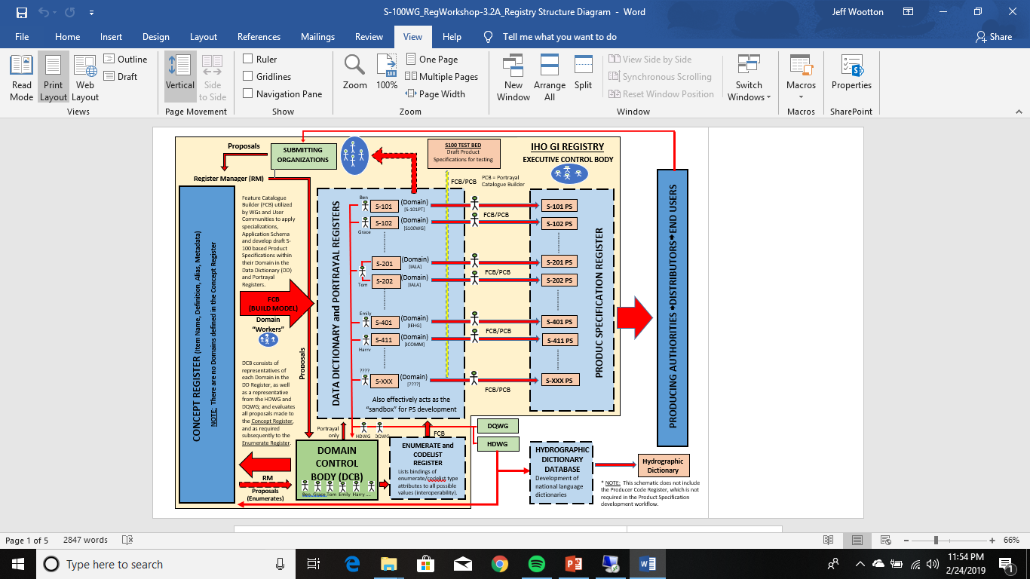
3.2 Registry structure and roles (“new”)

Slide 5
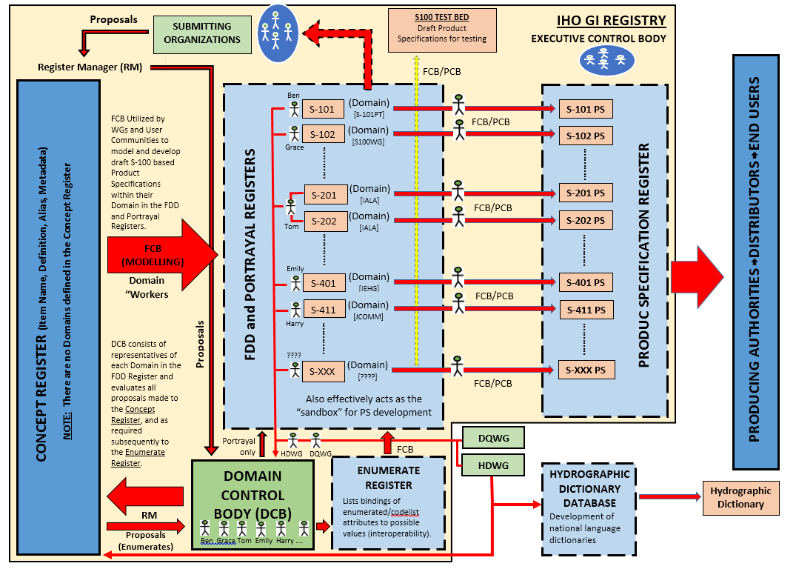
3.2 Registry structure and roles (“new”)

Slide 6
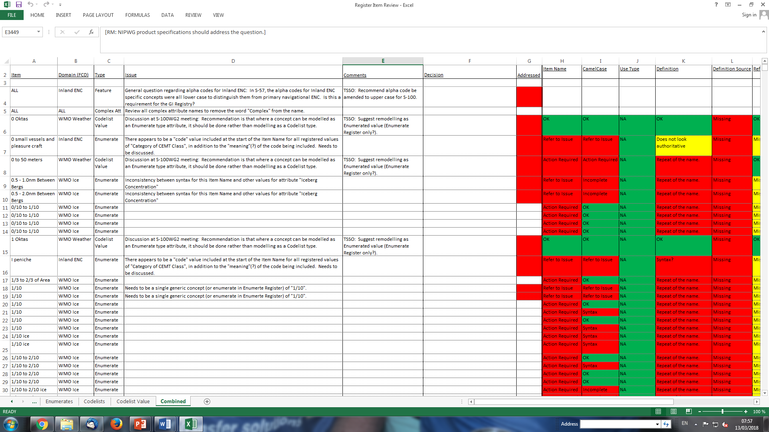
3.3 Registry content

Slide 7
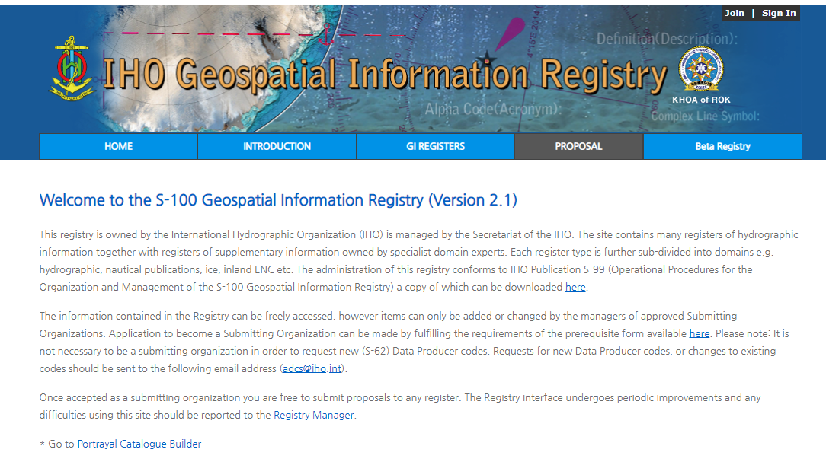
4.1 Registry interface – current Registry

Slide 8
4.2 Registry interface – “new” Registry
Demonstration – Beta Registry interface - KHOA

Slide 9
3.4 Challenges
Structure: Robust Registry structure however allowing flexibility within a multi-domain environment
Content: Consistent content of the Concept and Data Dictionary Registers based on approved conventions and guidelines
S-99 Annex A

Slide 10
3.4 Challenges - discussion
1) The Concept Register is effectively the “source” Register from which all hydrographically-relevant concepts are drawn for modelling in S-100 based Product Specifications.
A single instance only of each concept exists in the Register. Each concept must be unique (that is, no two concepts can be interpreted to describe the same “real world” entity), and is described by Item Name; Definition (with supporting metadata); Unique ID; Alias(s) (if any); Status (Valid, Invalid (or Not Valid), Superseded, Retired); Lineage and Maintenance Metadata; and a flag to identify whether the concept is included in the IHO Hydrographic Dictionary.
MRNs?
“Senses or “scopes” – Specializations of concepts implemented at the Data Dictionary level?

Slide 11
3.4 Challenges - discussion
Process:
Submitting Organization submits a proposal to the Register via the IHO GI Registry interface;
Proposal is assessed by the Register Manager for completeness and possible duplication with items already registered. If suitable, the proposal is forwarded to the Concept Register Domain Control Body. [If considered to be not suitable, the proposal is “rejected” and returned to the Submitting Organization for further rework/resubmission or withdrawal based on Register Manager comments.]
Proposal is assessed by the Concept Register Domain Control Body for suitability and possible impact on Product Specification(s) under the individual members’ area of expertise . If approved, the proposal is forwarded to the Register Manager for incorporation in the Register. [If rejected, the proposal is forwarded by the Register Manager back to the Submitting Organization for rework; or appeal by the Submitting Organization to the Executive Control Body.]

Slide 12
3.4 Challenges - discussion
Process:
Register Manager commits the approved change to the Concept Register, and the Submitting Organization is notified of the change, from which time the change is available for use in the Feature Data Dictionary Register and/or the Codelist Register*.
* Note that the Codelist Register is not included in the current implementation of the “Beta” Registry. Decision from the Workshop is that the requirement for this Register needs to be reworked and a justification Paper submitted to the S-100TSM7 meeting (September 2019).
As such, all slides related to the Codelist Register, and any further reference to the Codelist Register within this presentation, are to be interpreted as binding of enumeration or codelist type attributes and their values required within the Data Dictionary Register.

Slide 13
3.4 Challenges - discussion
The Data Dictionary Register is partitioned into Domains.
Each Domain may correspond to a single S-100 based Product Specification. It has been proven that having multiple Product Specifications being derived from a single Domain causes problems within the Domain as the possibility exists that multiple instances of a single concept modelled in different ways may be required in the Domain dependant on the requirement of each Product Specification. Multiple Product Specifications within a single Domain should be considered only where these Product Specifications share all (or most) of a single Application Schema; or the Application Schema for a Product Specification is essentially a “subset” of the Application Schema for another Product Specification.
Introduce scopes or namespaces? Need to develop a middle ground between total independence and total integration of different product specifications.

Slide 14
3.4 Challenges - discussion
Concepts are drawn from the Concept Register by nominated representative(s) from the relevant IHO Working Group or User Community, into a Domain within the Register. Within the Domain, Feature Catalogue development (assign geometry; type; binding; multiplicity) based on the Application Schema for the Product Specification is done.
The Application Schema (UML model) is developed first, then the Feature Catalogue. The product specification team cannot know which concepts are needed until the Application Schema is completed. It develops the Application Schema by a process of iterative refinement, referring to the Concept Register as a source (though not the sole source) of concepts within the scope of the data product. The Feature Catalogue is developed later. When the FDD is introduced, populating it will be an intermediate step between developing the Application Schema and Feature Catalogue.

Slide 15
3.4 Challenges - discussion
There is no overarching IHO GI Registry structure or process governing how the development work within a Domain is managed. This is the responsibility of the Working Group or User Community that is developing the Product Specification. There is no requirement for the Register Manager, Registry Manager, DCB, or ECB to be involved in the actual development of the Product Specification, except for the initial establishment of the Domain; processing new proposals from the Domain Submitting Organization representative to the Concept Register; and providing advice and guidance as required. All responsibility for ensuring a complete and robust process in order to produce a fit-for-purpose Product Specification are the responsibility of the governing IHO Working Group or User Community (noting however the existing approval process for IHO S-100 based Product Specifications).

Slide 16
3.4 Challenges - discussion
The process and participants for development and maintenance of the Product Specification can be organized by the Working Group or User Community responsible as required so as to best achieve the required end result. For example, the IHO S-101 Project Specification is being developed by a dedicated Project Team operating under the S-100WG, while S-102 was developed by a very small group of subject matter experts (essentially a “one man band”), and simply reported its progress to the S-100WG as required. Similarly, cooperation between Domains may be “sub-managed” by smaller cross-Domain groups in order to harmonize and optimize Product Specification development – for example the IHO Hydro “Cross-Domain Group” between the S-101 Project Team and the NIPWG. Again, it is important to note that this is not a part of the overarching administration or management of the IHO GI Registry.

Slide 17
3.4 Challenges - discussion
At any stage during Product Specification development, a draft product Feature and Portrayal Catalogue may be created (utilizing the Feature Catalogue Builder and Portrayal Catalogue Builder) from the Domain within the FDD Register for testing in the S-100 Test Bed. This effectively means that the Domain space within the Feature Data Dictionary Register acts as the “sandbox” for the iterative testing and refinement of the Application Schema and Feature/Portrayal Catalogues for the Product Specification.
When all requirements for the development, testing and approval of the Product Specification have been satisfied, the final Feature and Portrayal Catalogues are produced, utilizing the Feature Catalogue Builder and Portrayal Catalogue Builder, and included in the published Edition of the Product Specification.

Slide 18
3.4 Challenges - discussion
The published Product Specification is included in the Product Specification Register, which holds all published versions of the Specification. From this point, further development can be done in the FDD Register for refinement of the Application Schema in preparation for the next draft of the Product Specification, as required.

Slide 19
3.4 Challenges - discussion
Process:
The Working Group/User Community, if required, applies to the Registry Manager to have a Domain assigned to them for an S-100 based Product Specification, if a Domain does not already exist
When approved by the Registry Manager, the Domain is established. The Working Group/User Community then assigns representative(s) of their group to act as Submitting Organization, Domain Control Body and Domain “Worker”. The Domain “Worker” essentially has write access to the Domain for the application of the data modelling as defined in the Application Schema for the Product Specification, and is given access to the Register so as to draw concepts from the Concept Register so as to reflect the Application Schema and create draft Feature Catalogues for testing and final publication

Slide 20
3.4 Challenges - discussion
Process:
Based on draft modelling included in their Application Schema, the Working Group/User Community for which the Domain has been created extracts concepts from the Concept Register, and models the concept according to their requirements (assigns geometry, type, binding, cardinality, encoding guidance). This is done by the Domain “Worker”. The Registry interface provides a query mechanism whereby users of the Registry can enquire as to how a concept from the Concept Register has been modelled in all instances of its use in the FDD Register and within the Codelist Register – this will assist in Product Specification development and contribute to interoperability

Slide 21
3.4 Challenges - discussion
Process:
Proposals for new or revised concepts required to the Concept Register are proposed by the Submitting Organization representative for the Domain as required
As required, a draft Feature Catalogue can be extracted from the Domain, utilizing the Feature Catalogue Builder, for testing in the S-100 Test Bed

Slide 22
3.4 Challenges - discussion
3) It is anticipated that the Portrayal Register will be structured and function essentially as it exists in the current version of the Registry.

Slide 23
3.4 Challenges - discussion
Codelist Register:
The intention of the Codelist Register is to provide the mechanism for ensuring consistency and interoperability between data created conformant to S-100 based Product Specifications. The Register is a “Hierarchical Register”, and contains all instances where a property or characteristic of a concept has been modelled in an S-100 based Product Specification as an “closed enumeration” (enumerated attribute) or an “open enumeration” Codelist type; and the full list of allowable enumerate codes and their values (which may also be taken from the Concept Register) for the attribute. This Register may also contain those attributes defined as Dictionary type Codelists through assigning the administrative URL to the attribute (see INSPIRE Registry).

Slide 24
3.4 Challenges - discussion
The rationale behind the establishment of an Enumerate/Codelist Register is that, if such a Register does not exist, Product Specification developers could create their own enumerate lists for the same enumerate type attribute, having different values assigned to enumerate codes. This would cause considerable problems with interoperability.
NOTE: Discussion as to whether there should be separate “Hierarchical Registers” for enumerates and codelists (refer to INSPIRE Registry model), rather than a single Register, is required. An alternative is to have 2 Registers – the first being a “fixed list” Enumerate Register for enumerated lists that are stable (that is, are not intended/forecast to change); the second being an extensible “Codelist Register” containing lists that equate to an “open enumeration” Codelist that can be implemented in a Feature Catalogue as Enumeratred or Codelist type. [TSSO: Note the reference to the “Classification Item Type” in the INSPIRE Registry below.]

Slide 25
3.4 Challenges - discussion
As for the Concept Register, the Codelist Register is “domainless”. There must only be a single instance of any concept from the Concept Register defined as a “parent” attribute in the Codelist Register, with all possible values (codes) as used in any S-100 based Product Specification listed against that attribute. User communities may then define a “subset” of the listed values dependant on the requirement of their Product Specification.
Need use cases and examples to demonstrate why the Register would need to be partitioned.
I’d like a clarification of the paragraph in question later, but pending that:
Some concepts are very general and very broad, e.g., « status » in ENC vs. AIS vs. Lighthouse authority databases.
The « berthing » term in the comment above.

Slide 26
3.4 Challenges - discussion
Enumerated attributes may be taken directly from the Concept Register; or derived from the Concept Register (an example may be the “category of …” enumerated attributes). [These may not be the only options – see below for discussion required as to unique “coded” lists.]
Data modellers working within their Domain within the Data Dictionary (DD) Register access the Codelist Register using the Registry interface. They can select attributes from the Register based on their Application Schema, and bind them to the appropriate features/information/complex attributes within their Domain in the DD Register, selecting only those required values (codes) from the allowable full list to satisfy the requirements for their Product Specification .
Amounts to defining a derived datatype.

Slide 27
3.4 Challenges - discussion
As required, Submitting Organization representatives for a Domain can submit a proposal to the Register (and the Concept Register as required) to add new Enumerate or Codelist type attributes (and / or new enumerated values to existing attributes within the Register). The management of content and administration of the Register is as for the Concept Register.

Slide 28
3.4 Challenges - discussion
NOTE possible partitioning of this Register into 2 “Domains” – a “conventional” Domain in which the attribute and its values are derived from the Concept Register ; and a “classification code” Domain where the attribute is drawn from the Concept Register but the values are from a set (and mostly administered by external organizations however fixed) list of “codes” (refer to draft Register Guidelines and Conventions document, and also the first bullet above). NOTE: In the INSPIRE Registry there is actually a “Classification Item Type” (Parent?) that equates to the “classification code” Domain mentioned above. This also includes links to external Codelists.
To take this a step further, perhaps the Enumerate Register can be structured so that enumerate values can be taken from the Concept Register if they are actually concepts; or registered directly in the Enumerate Register as (for want of better words) “characterizations” or “states” of a concept, in addition to classification codes. Will need to investigate this further with structures of other Registries.

Slide 29
3.4 Challenges - discussion
Process:
Data modellers working within their Domain, when requiring a registered item in the Concept Register, or a specific property or characteristic describing a concept in the Concept Register, to be an enumerate type attribute within their data model, query the Enumerate Register(s) for the existence of the attribute. If the attribute does not exist, they submit a proposal to the Register in the same manner as would be done for the Concept Register, noting however the additional hierarchical requirement to propose both the attribute and its values (or its referencing URL if the Codelist is a Dictionary type). Proposals are assessed by the Register Manager and Domain Control Body and actioned accordingly. The same process is followed if there is a requirement to add a new value (code) to the enumerate list for an already existing attribute.

Slide 30
3.4 Challenges - discussion
The attribute is imported from the Codelist Register into the DD Register, based on the model defined in the Application Schema; only those values (codes) for the attribute required for the Product Specification (which may or may not be the entire list of allowable values) are retained; and bound to features or complex attributes as required (with perhaps further restriction of the allowable enumerate list) in accordance with the Application Schema.

Slide 31
3.4 Challenges - discussion
Product Specification Register:
The Product Specification Register holds the published versions of all S-100 based Product Specifications.
Process:
When all requirements (testing, approvals, …) for the development of the Product Specification have been met, and the final components of the specification have been produced (Product Specification document (including Data Classification and Encoding Guide); Feature Catalogue; Portrayal Catalogue), the new published version of the Product Specification is added to the Product Specification Register.

Slide 32
3.4 Challenges - discussion
The previous version of the Product Specification should normally be given the status of “Superseded” (note however the occasional possible exception as with S-52 PL, S-64 and S-58).

Slide 33
3.4 Challenges - discussion
Submitting Organizations:
In general, there should be at least one member of each of the Domains in the Data Dictionary Register nominated to be a Submitting Organization representative for the relevant Working Group or User Community. However, where two or more Domains are under the management of a single User Community, a single Submitting Organization representative may be identified to cover all relevant Domains; this is at the discretion of the Working Group/User Community.
How are applications for Submitting Organizations (and other Roles) to be assessed by the Register Manager? Suggest that the Register Manager retains a list of contacts that equate to “Domain Administrators” that may be contacted to confirm the legitimacy of an application?

Slide 34
3.4 Challenges - discussion
6) Concept Register Domain Control Body (DCB) :
The Concept Register Domain Control Body is comprised of a member of each of the Domains in the Data Dictionary Register; and a member of each of the HDWG and DQWG.

Slide 35
3.4 Challenges - discussion
A member of the Domain Control Body is effectively the representative of the IHO Working Group or User Community utilizing the IHO GI Registry to develop and maintain S-100 based Product Specifications. The method by which each Domain Control Body member disseminates/discusses proposals within their expert group(s) (if at all) is at the discretion of the individual IHO Working Group or User Community for which the Domain has been created, and is therefore independent of the overall IHO GI Registry management process.

Slide 36
3.4 Challenges - discussion
Example: For the S-101 ENC Domain of the DD Register, a single person from the S-101PT (or ENCWG once S-101 is operational) is appointed as the Concept Register DCB representative. When proposals are submitted to the Concept Register, the S-101 DCB representative assesses each proposal on its merits as to the action to take – this may range from accepting the proposal without consultation (if for instance there is no impact on S-101); to initiating a full consultative process within the S-101PT/ENCWG (if for instance there may potentially be significant impact on S-101).

Slide 37
3.4 Challenges – Further questions
Refer paper RegWS1-3.2B.

Slide 38
5 Registry content standardization
Some statistics (at March 2018):
Total number of registered (Valid) items: 4610
[321 Features]
[17 Information]
[577 Simple Attributes]
[104 Complex Attributes]
[3400 Enumerates]
[19 Codelists]
[172 Codelist Values]
Number of registered (Valid) items considered to have “no issues*”: 57
* No identified Issues, Comments or red entries in columns H-T. Note however that this includes the Definition Source column being considered to be mandatory, which is not currently the case. It is also important to note that “no issues” is in relation to the draft guidelines and conventions which are yet to be approved.

Slide 39
5 Registry content standardization
Item Name considered suitable: 1065 [Based on draft conventions].
camelCase OK: 2508 [Majority of issues are missing camelCase].
Use Type: [A few issues only, noting that this is only allowable for Feature Types. Those issues identified are generally related to questions regarding modelling].
Definition considered OK: 1836 [Major issues are missing definitions; and repeat of (or almost repeat of) the name].
Definition Source provided: 115 [This Metadata field is a drop-down list of sources. In some cases, the Definition Source is entered as the Reference (assume this is because the option is not available in the drop-down list)].
Definition Reference provided: 252 [This does not include entries that are considered to be the Definition Source, which have been classified as Issues].
Similarity to Source provided: 141 [In many cases the definition is an adaptation (“Restyle” in drop-down list?) as indicated in S-57 or S-101, however this has not been populated].

Slide 40
5 Registry content standardization
Alpha Code provided: 638 [As has been stated above, this Metadata field is not available to all Types, and in many cases has not been populated if it is available. Note that for IEHG items, where provided the Alpha Code is lower case].
Alias: [Only a few Alias’s provided. Needs discussion as to purpose – refer to Guidelines and Conventions draft.].
INT1: Populated: 74 N/A: 3647 [The majority of INT1 references, where they are relevant, have not been populated. It is important to note the number of items that do not require INT1 references].
S-4: Populated: 81 N/A: 3610 [The majority of S-4 references, where they are relevant, have not been populated. It is important to note the number of items that do not require S-4 references].
Distinctions provided: 34 [Note that this field is currently labelled “Distinguishing Features” in the FCD Register. The majority of “distinctions” identified in S-57 and S-101 have not been populated].
Remarks: [Relatively few items have remarks, and these tend to be specific to modelling or feature binding rather than remarks regarding the concept itself].

Slide 41
5 Registry content standardization
Repeated Concepts: In general, this is a consequence of the current structure and interface of the FCD Register. A single concept cannot be registered once and then used as different Types (Feature, Attribute Enumerate, …) in different Feature Catalogues across different Domains; or bound to different Features/Attributes within a Feature Catalogue, unless it is registered multiple times in accordance with its usage. In addition to non-conformance with a fundamental principle of a concept register (register once, use many times), this has also resulted in the following issues:
Same concept registered more than once with more than one meaning and definition (example: Reed (Category of Vegetation); Reed (Category of Fog Signal), although please note in this case that the concepts and definitions are contextual);
Concept that is essentially the same registered multiple times with different Item Names (example: Undefined; Undetermined or Unknown; Undetermined, Unknown, or No Form (used in …..); Undetermined/Unknown; Undetermined/Unknown – Ice Stage of Development (SS); Unknown; Unknown Coverage; Unknown Status; etc …);

Slide 42
5 Registry content standardization
Recommendation: The Concept Register and the rules/guidance for its use should be flexible enough to accommodate Product Specification development in different domains, while encouraging harmonization and a common conceptual framework for different Product Specifications. This suggests possible use or adaptation of an architecture based on lexical databases (for example introduction of “scopes” for items, utilizing namespaces) or ontologies.

Slide 43
5 Registry content standardization
Repeated concepts: Items registered multiple times, and intended for the same purpose, during different iterations of the FCD Register. As a consequence, many of these instances have not been assigned to a Domain (example: First Stage Thin First Year Ice 30-50 cm (Enumerate)).
Recommendation: Retire instances of repeated item names that have not been assigned to a Domain; and retire duplicates of items that have identical Metadata that have been assigned to a single Domain.

Slide 44
5 Registry content standardization
General Syntax/Format: This is a common issue across all fields populated for items in the FCD Register, and impacts on almost all items in the Register. This is principally due to the lack of conventions and guidelines. Some of the most common issues identified include: Use of capitals; use of acronyms/abbreviations; length (item name); inconsistency between syntax in related concepts (for example “2 cones, base to base” v “2 cones (points downward)”); combination of full name and acronym/abbreviation as Item Name; multiple terms (principle term and alias’s?) included as Item Name (examples: “barrel (tun)”; “stake, pole, perch, post”).
On the other hand, it will be extremely difficult to define universal conventions and guidelines, which further are unlikely to be accepted by all Domains and Product Specifications. Any set of conventions or guidelines should therefore focus on local consistency – roughly speaking, ensuring that items that appear in juxtaposition (for example, different members of the same enumeration) are mutually consistent, instead of global consistency (universal rules applying to every item of the same kind).

Slide 45
5 Registry content standardization
Recommendation: A consolidated “Conventions and Guidelines” document is approved and published; and all concepts in the FCD Register assessed against this document and amended as appropriate before inclusion in the “Concept Register”. This assessment should focus on local consistency rather than universal consistency.

Slide 46
5 Registry content standardization
Items not assigned to a Domain; and enumerates not assigned to an attribute: Assume this is a result of bulk population of the Register in previous versions of the Registry. NOTE: Search conducted by Denise LaDue (utilizing Alpha Code) to identify likely bindings of enumerates to an enumerated type attribute where this binding is not identified in the Registry interface – this will need to be applied before the application of the recommendation below.
Recommendation: Retire all items in the Register that have not been assigned to a Domain; and similarly retire all Enumerated items in the Register that have not been assigned to an Attribute.

Slide 47
5 Registry content standardization
Disparity between Item Name and Definition: There are many such instances in the FCD Register, and in most cases these are instances of very specific terms having very generic definitions (although the opposite also occurs). Often, disparity arises from the definition depending on a particular context, which is set by the definition of the containing item (for instance, the definition of an enumeration sets the context for definitions of enumerates which are members of the enumeration). This has the potential to cause problems where concepts are used across multiple Product Specifications. The dilemma in resolving this issue is the level of specificity that is used. Is there a “one size fits all” that can be clearly defined in the Conventions and Guidelines; or should the guidance be more general in advising on the considerations for the use of a proposed item (and its definition) in other S-100 based Product Specifications?

Slide 48
5 Registry content standardization
Recommendation: All identified instances of disparity between an Item Name and its definition must be resolved. In order to achieve this, there must be agreement on how a consistent approach is going to be reflected in the “Conventions and Guidelines” document. The principle of scopes utilizing namespaces is especially needed for enumerates (that is, literals, or listed values).

Slide 49
5 Registry content standardization
Non-Authoritative Definitions: In association with resolving the above issue, there are many instances where the definition appears to be non-authoritative. In a large number of these instances, the definition is merely a repeat (or almost a repeat) of the Item Name. In some cases, the concept has been defined by a Working Group or Project Team to address specific modelling requirements in their domain.
Recommendation: Review all definitions in the Register and amend as required to provide an “authoritative” definition. For the Concept Register, assign mandatory status to the “Definition Source” metadata field. Product specification developers should make every effort to research and use existing authoritative definitions and sources, but the working group may be cited as the source when it develops a new concept.

Slide 50
5 Registry content standardization
camelCase: Varies from abbreviations of item names to examples so long that they are truncated (assumedly by the interface). There are items that have punctuation, acronyms, “special characters” or numbers. There are also items where the camelCase is missing. Also need to agree on basic syntax to be used in the (Type-neutral) Concept Register.
Recommendation: Develop standard format for camelCase for incorporation in the “Conventions and Guidelines” document and subsequent review within the Register. Assign the “default” camelCase (first letter of first word lower case, all following first letters upper case) as the format for the Concept Register. Develop guidance discouraging the use of long camelCase codes/names.

Slide 51
5 Registry content standardization
References or inferences to data modelling, or encoding guidance, included in Definitions and/or Remarks: Given that the Concept Register is “generic”, there should be no information that relates to data modelling or encoding that is specific to a Product Specification included in the Metadata. If it is considered that such information should be included in the Registry, this should be done by additional remarks (additional Metadata field?) in the Feature Concept Dictionary Register Domains. However, given that this is provided in the Data Classification and Encoding Guide for each Product Specification, should this information also exist in the Registry?
Recommendation: Remove references to data modelling and encoding from the Metadata. Investigate options for including such information, if considered it is required, in the Feature Data Dictionary Register.

Slide 52
5 Registry content standardization
INT1 and S-4 references: As mentioned in the Register summary information above, it is important to note that the vast majority of registered items do not have any reference to INT1 or S-4. TSSO analysis to date indicates that there are about 900 items that have valid INT1 references and 950 items that have valid S-4 references. Consideration should also be given to those Organizations such as WMO and IALA for which the majority (or all) of their required items will have no relevance to INT1 or S-4. The question therefore is whether it is appropriate or necessary to include INT1 and S-4 references as Metadata fields for items registered in the Concept Register? Perhaps this could be an additional Metadata field that can be included for items in the Feature Data Dictionary Register (such as within the S-101 Domain)?
Recommendation: Consider the capability of including INT1 and S-4 references only within the required Domains within the Feature Data Dictionary Register.

Slide 53
5 Registry content standardization
“Distinctions”: Within the current FCD Register interface, this Metadata field is labelled as “Distinguishing Features”. Consider this is an error in the interface, and this Metadata field should be labelled “Distinctions”. Consider this is perhaps a reason why this field is not populated for almost all items currently registered. Note also that this field is only currently available for Feature Types.
Recommendation: Amend field name from “Distinguishing Features” to Distinctions and include as a Metadata field in the Concept Register. Request Submitting Organizations to conduct a review of all their registered items and submit proposals to add distinctions as required.

Slide 54
5 Registry content standardization
“Coded” Enumerate Lists: Within the Enumerate Type, there are many items registered that are “Codes” that sub-divide a unique concept (some are lists maintained by other Organizations, such as IUCN Codes); or define “gradations” of a concept (examples: 0 Oktas, 1 Oktas, 2 Oktas, ….; 1/10, 2/10, 3/10, ….). Should these “Coded” (for want of a better word) enumerated lists of values be registered as “Concepts”? How can something like “1/10” be defined if it is considered to be a Concept, and what defines such a concept as “hydrographically relevant”? This needs careful consideration, as this may be extended to other enumerate lists (example: Topmark Shape). The European Commission INSPIRE Registry has included an “Enumeration Register” within its Registry structure; and perhaps this needs further investigation as a possible solution.
Different Product Specifications define different enumeration attributes which have different meanings but can still take the same set of values. At present S-100 assumes a 1/1 correlation between an enumeration attribute and its value space. The result is that each enumeration attribute implies a unique enumeration type.

Slide 55
5 Registry content standardization
Recommendation: Include an “Codelist Register” as a hierarchical register in the IHO GI Registry structure. Refer to Registry Structure Diagram document and INSPIRE Registry. Use enumerations defined in this Register as datatypes for enumeration and Codelist attributes.

Slide 56
5 Registry content standardization
Metadata fields not available for different Types: As stated in the review spreadsheet description above, the Use Type and Alpha Code Metadata fields are not valid fields for some Types. A decision needs to be made if these fields should be retained in the Metadata for items registered in the Concept Register. TSSO opinion is that the Use Type field is specific to modelling so should not be valid at the concept level, however it will need to be defined at the Feature Data Dictionary level. For Alpha Code, TSSO questions whether this field is required at all, given the implementation of camelCase. Is this just a legacy inherited from S-57 to be used for cross-referencing? Is there a requirement in ISO to include Alpha Codes?
Recommendation: The Use Type field should not be a valid metadata field in the Concept Register, however it is required in the Data Dictionary Register. Discussion is required as to the retention of the Alpha Code Metadata field.

Slide 57
5 Registry content standardization
General observations regarding S-57-based Register content: There are a number of entries in the Register that have been taken from S-57 but are not being used in S-101 (or any other Product Specification). These need to be assessed to determine whether they are required in the Concept Register.
Also, while the benefits of basing the modelling for S-101 on the S-57 modelling are acknowledged, particularly in regard to converting S-57 datasets to S-101, this has to a certain extent restricted any extension or possible improvement to the modelling that experience with S-57 and additional functionality available in S-100 could provide. (Example: Category of Recommended Track is an enumerated attribute with 2 values – “based on fixed marks” and “not based on fixed marks”. This could be remodelled to a Boolean attribute “Based on Fixed Marks”.)

Slide 58
5 Registry content standardization
Recommendation: Review all Register entries that have been derived from S-57 that are not used in S-101 and, unless use cases can be found for retention, retire these items.
A possible action that can be taken, which is not directly related to the structure and operation of the Registry, is to recommend to the S-101PT that consideration be given to extending/refining the S-101 data model beyond the requirements to convert S-57 data.

Slide 59
5 Registry content standardization
Enumeration and Codelist members: There are many collisions between the names and definitions of enumerates (that is, literals, or members of enumerations/codelists) which were originally defined in different domains, or draw on different sources for their names/labels and definitions.
The enumerated value concepts draw on different sources, and their meanings, names/labels, and definitions depend on the context in which they are defined, a unified list will be extremely difficult to develop and require wholesale revision of all S-100-based Product Specifications currently under development.
Recommendation: Introduce the principle of scopes to the registers, especially the proposed Codelist Register, as containers for enumerates. Define enumerates as being meaningful only in the context of their containing scope.

Slide 60
5 Registry content standardization
Units: Several product specifications need units of measure, either for metadata or to encode inside datasets. Some domains have defined units with varying spellings.
Recommendation: Define a separate register of units.

Slide 61
5.1 Discussion: Concepts
Demonstration – Beta Registry interface - KHOA

Slide 62
THANK YOU
For more information: https://www.iho.int
IHO Secretariat Contact: jeff.wootton@iho.int

